Slide 1
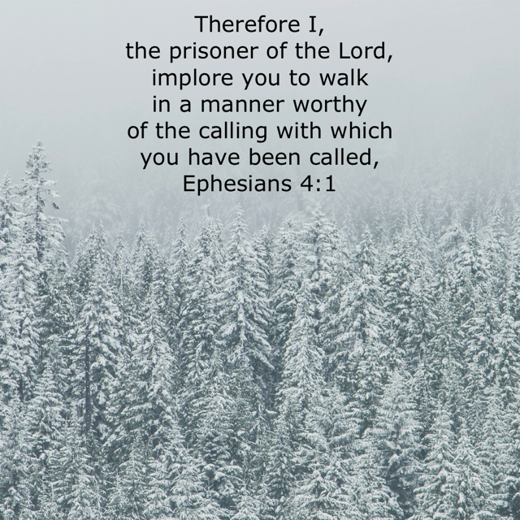

Long Term Prayer List
Keira Roberts- Ankle
Henry Lind- Knee
Susan Tanner- Cancer
Alijah (Paulina’s Grandson)
Alena (Rex Boggs' Daughter)- Cancer
Larry Aycock
Lauren Babb
Jackie Streety-Healing
Minerva Peeler- Health
Eric Johnson (Paige’s Dad)- Health
Tessie Johnson (Paige’s Grandma)
Mary Brazowski-Health
Paulina Alvarez
Peggy Walls
Sharon Saint
Barbra and James Westbrook
Clyde Sepeda
Ronnie Raburn (Perry’s Brother)- Bone Cancer
James Bundrant (Perry’s Brother-in-law)- Cancer
Linda Hosty (Paulina's Cousin)
Linda Davis- Rehab and Improvement
Gina Standefer (Susan’s Sister-in-Law)
Larry and Faye Patterson- Health
Heather Kilpatrick- Debbie's Cousin
Charla Mills (Charlie's Mom)- Healing
Boggs-House
VISITOR INFORMATION
If you are a guest, we would love to get to know you better! Please fill out an information card from the pew rack, place it in the front collection box, or leave it at the end of your pew.
CLASS AND SERVICE ROTATIONS
SUNDAY Wednesday
PreK- K- Michelle PreK- 2nd- Taylor
1st-3rd- Cheryl Pre Youth- Paige
5th-6th- Angie and Janet Youth Group- Chrismon's
Youth Group– Annex- Paige. Adult- Charlie
Adult– Charlie
WEEKLY EVENTS
Ladies Class Mondays at 5:15 p.m.
Tuesday Morning Men’s Breakfast- 7 a.m.
Wednesday Class 6 p.m.
Sunday Class 9 a.m.
Sunday Service 10 a.m.
WEDNESDAY NIGHT MEAL 5:15
December 20- Janet Ruper
ISF Security
December 17- Perry Winegeart December 17 Gerald Fougerat
December 24- Charlie Mills December 24 Jared Koonce
December 31- Ralph Mason December 31- Ross H IV
GONZALES CHURCH OF CHRIST
DECEMBER 17, 2023
CONTACT US
830-203-5147
1323 Seydler St.
Gonzales, TX 78629
@GTXCHURCHOFCHRIST
www.gonzaleschurchofchrist.org

Slide 2
ANNOUNCEMENTS
December 19th, join us in seeing the Christmas lights in Cuero. Van will be leaving at 6:15 p.m.
Fellowship On The 31st
WEEKLY PRAYER REQUESTS
Lauren Babb
Charla Mills
BIRTHDAY & ANNIVERSARIES
21st- Sharron Boggs
22nd- Keira Roberts
WEEKLY BIBLE READINGS
December 17th- Philippians 1-4
December 18th-1 Timothy 1-6
December 19th-Titus 1-3
December 20th-1 Peter 1-5
December 21st-Hebrews 1-6
December 22nd-Hebrews 7-10
December 23rd-Hebrews 11-13
BY THE NUMBER
WEEKLY CONTRIBUTION OFFERING: $925
SUNDAY MORNING SERVICE: 50
SUNDAY BIBLE CLASS: 29
WEDNESDAY BIBLE CLASS: 31
ISF: 1
TODAY’S SERVICE
WORSHIP LEADER- JARED COBURN
#38-AWESOME GOD
CALL TO WORSHIP
JARED KOONCE
#266- MAJESTY
#97- I SING PRAISES
#2- WE PRAISE THE O GOD
LORD'S SUPPER
ROSS HENDERSHOT
#77- GLORIFY YOUR NAME
#155- HIGHEST PLACE
#238- YOU ARE THE SONG THAT I SING
SCRIPTURE READING
ACE
MESSAGE
PSALM 96
#300-PRAISE HIM! PRAISE HIM!
ANNOUNCEMENTS
PERRY WINEGEART
EXHORTATION
CADEN CHRISMON
Notes

